Slide 1
Simple bot scenario
Am I speaking with {{tableDrivers.driverName} ?}
No
{{ table.Result. driverConfirmation }} = Not
<hangup>
Yes
Yes
Are You reach destination on time ?
{{ table.Result. deliveryOnTime }} = Yes
<hangup>
No
How many kilometers You have to destination
{{ table.Result.distanceToDestination }} = kilometers: string
<hangup>

Slide 2
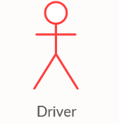
DB diagram on mongo DB
Source mongo table for calls
Result mongo table
tableDrivers
-id: number PK
-driverName: string
-phoneNumber:string
tableResult
-id: number PK
-phoneNumber:string
-driverConfirmation:string
-deliveyOnTime:string
-distanceToDestination:string
-dateTimeStamg:datetime
Bot call to driver
Bot save result in mongo
Upload table:
Manual update
Json
Excel
CSV, Txt

